Slide 1

Analyzing Robustness of Kernel 0 Anti-cheat Systems
PROJECT GOALS
SOFTWARE DESIGN
DEVELOPMENT
ANALYSIS
Machine Vision
2022
Using Computer Vision and Machine Learning
By: Alexander Weldon, CSSE
Advisor: Arkady Retik, CSS | Sponsor: Morgan DuBois

Slide 2
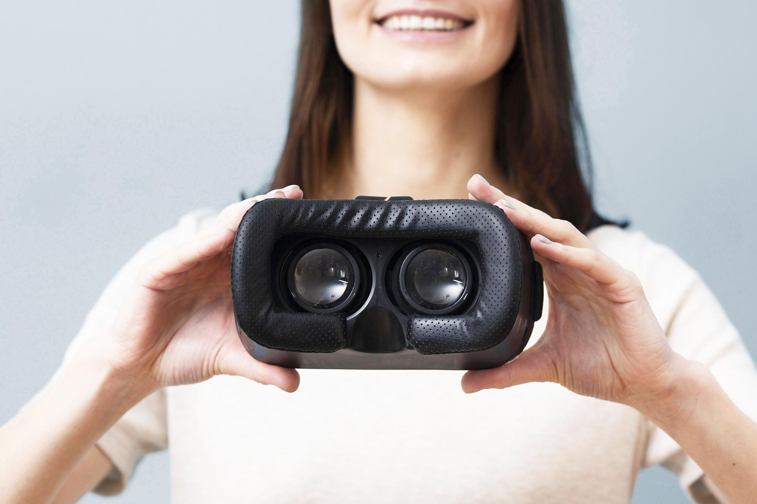
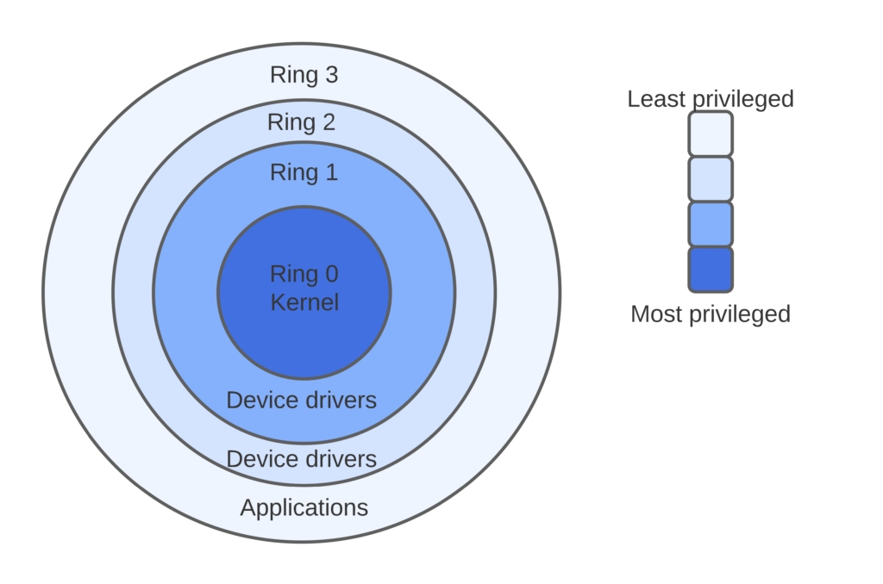
Kernel 0 Anti-Cheat
PROJECT GOALS
SOFTWARE DESIGN
DEVELOPMENT
ANALYSIS
2022
Kernel 0 anti-cheat systems are an aggressive solution to combat cheating in video games. These systems run at the 0 kernel level of PC. Meaning the program has the same authority as the operating system
KERNEL DIAGRAM

Slide 3
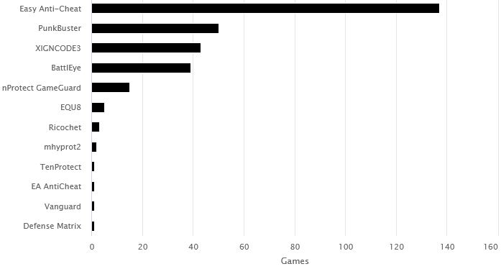
PROJECT GOALS
SOFTWARE DESIGN
DEVELOPMENT
ANALYSIS
Multiple Anti-cheats
Used across 300 different
Games from different publishers
Twitch most streamed games
Including, Apex Legends, Valorant, Fortnite all use versions of kernel 0 anti-cheat

Slide 4

PROJECT GOALS
SOFTWARE DESIGN
DEVELOPMENT
ANALYSIS
VALORANT
Any vulnerabilities in the anti-cheat system are also a direct vulnerability to a user's PC as long as the anti-cheat is running
In the case of valorants anti-Cheat Vanguard is always running.

Slide 5
PROJECT GOALS
SOFTWARE DESIGN
DEVELOPMENT
ANALYSIS
Idea
GOAL
stimulate the discussion of the inherent security risks in Kernel 0 anti-cheat systems by exploring how such systems may be bypassed in the future.
If Kernel 0 systems have access to anything that happens on the system what if the cheat runs from outside the system?

Slide 6




Tools used
01
02
Open Broadcast Software
Python
04
03
Aim Labs
OpenCV
PROJECT GOALS
SOFTWARE DESIGN
DEVELOPMENT
ANALYSIS
Used to stream gaming PC video stream to Computation PC
Language the project is written in
A specific library in Python used for machine vision
Used for testing of the software

Slide 7
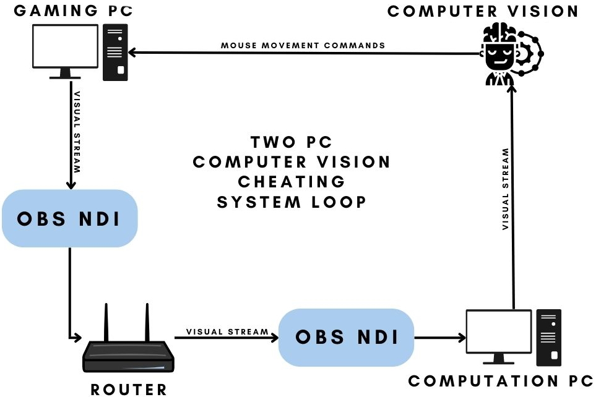
PROJECT GOALS
SOFTWARE DESIGN
DEVELOPMENT
ANALYSIS
Architecture of the system

Slide 8
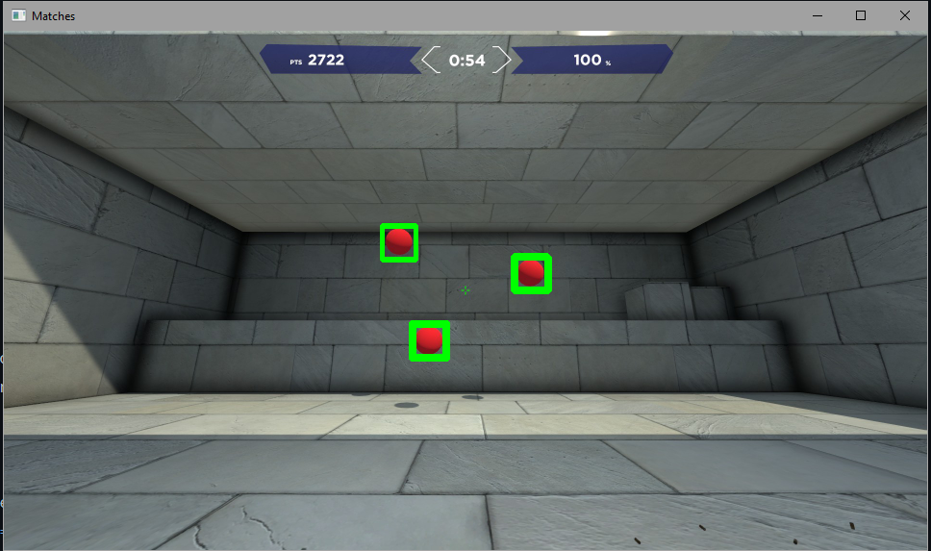
03
Developing
PROJECT GOALS
SOFTWARE DESIGN
DEVELOPMENT
ANALYSIS
Aim Labs Targets
Computer Vision and Machine Learning Algorithm

Slide 9
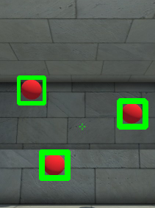
Finding Matches
PROJECT GOALS
SOFTWARE DESIGN
DEVELOPMENT
ANALYSIS
Matches
The first step in the process was getting the system to recognize the target.
First an image of the target needs to be given to the program
Program takes a screenshot of the game every couple of seconds
Screenshot is then fed into OpenCV which uses machine learning to search the image
Adjust threshold to find best matches without false positives

Slide 10
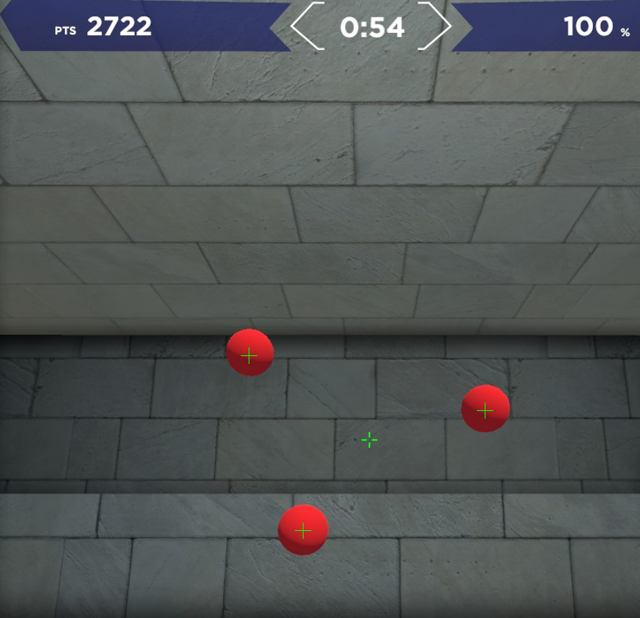
Grouping Matches
PROJECT GOALS
SOFTWARE DESIGN
DEVELOPMENT
ANALYSIS
Close Overlapping matches are grouped into click points. The click points are used later as coordinate locations to move the mouse to.
Click Points

Slide 11
Optimization
FPS counter
RGB Sliders
HSV Sliders
PROJECT GOALS
SOFTWARE DESIGN
DEVELOPMENT
ANALYSIS
I created a system to count the time between each screenshot to ascertain the efficiency of the system.
I created RGB value modifiers to modify the original image to remove targets that were not a specific color
HSV sliders modified the Hue, Saturation, and Vibrance of a screenshot to remove background objects and reduce the targets from 3d objects to flat colored objects

Slide 12
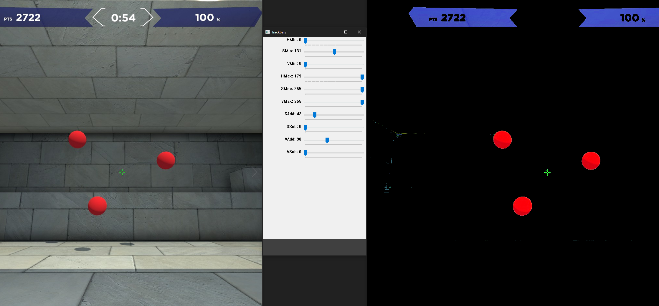
PROJECT GOALS
SOFTWARE DESIGN
DEVELOPMENT
ANALYSIS
HSV image manipulation

Slide 13
Challenges
Optimization
Resolution
Testing
Python Mouse
Sockets
Python
PROJECT GOALS
SOFTWARE DESIGN
DEVELOPMENT
ANALYSIS
Was a constant challenge
Differences in resolution between the two machines
Sadly I could not test my program against any anti-cheats
The commands I used to move the mouse ended up being blocked
Communicating Mouse commands over socket
Doing this in a language I have only ever used for one class

Slide 14
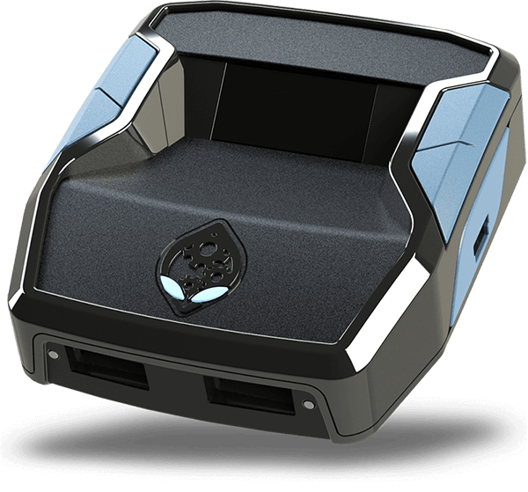
Future Work
PROJECT GOALS
SOFTWARE DESIGN
DEVELOPMENT
ANALYSIS
Test this Against preferably multiple actual kernel 0 anti-cheat systems
Find an alternative way to make mouse commands
Create a smaller form factor device
Explore ways to counteract this form of cheating

Slide 15
